Slide 1
Foundations of Cryptography PRF, IND-CPA from PRF
LiangFeng Zhang
zhanglf@shanghaitech.edu.cn
SIST, ShanghaiTech, 2019F

Slide 2
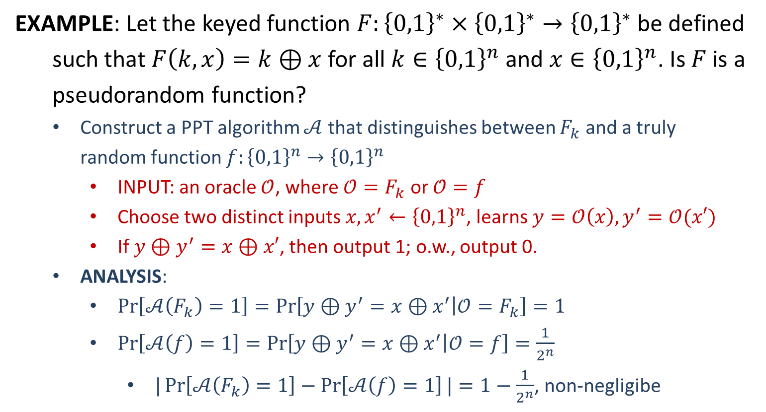
PRF
EXAMPLE: Let the keyed function $F:{\left\{0,1\right\}}^{∗}×{\left\{0,1\right\}}^{∗}→{\left\{0,1\right\}}^{∗}$ be defined
such that $F\left(k,x\right)=k⊕x$ for all $k∈{\left\{0,1\right\}}^{n}$ and $x∈{\left\{0,1\right\}}^{n}$. Is $F$ is a pseudorandom function?
Construct a PPT algorithm $𝒜$ that distinguishes between $F_{k}$ and a truly random function $f:{\left\{0,1\right\}}^{n}→{\left\{0,1\right\}}^{n}$
INPUT: an oracle $𝒪$, where $𝒪=F_{k}$ or $𝒪=f$
Choose two distinct inputs $x,x^{′}←{\left\{0,1\right\}}^{n}$, learns $y=𝒪\left(x\right), y^{′}=𝒪(x′)$
If $y⊕y^{′}=x⊕x′$, then output 1; o.w., output 0.
ANALYSIS:
$\operatorname{Pr}\left[𝒜\left(F_{k}\right)=1\right]=\operatorname{Pr}\left[y⊕y^{′}=x⊕x^{′} | 𝒪=F_{k}\right]=1$
$\operatorname{Pr}\left[𝒜\left(f\right)=1\right]=\operatorname{Pr}\left[y⊕y^{′}=x⊕x^{′} | 𝒪=f\right]=\frac{1}{2^{n}}$
$|\operatorname{Pr}\left[𝒜\left(F_{k}\right)=1\right]−\operatorname{Pr}\left[𝒜\left(f\right)=1\right]|=1−\frac{1}{2^{n}}$, non-negligibe

Slide 3

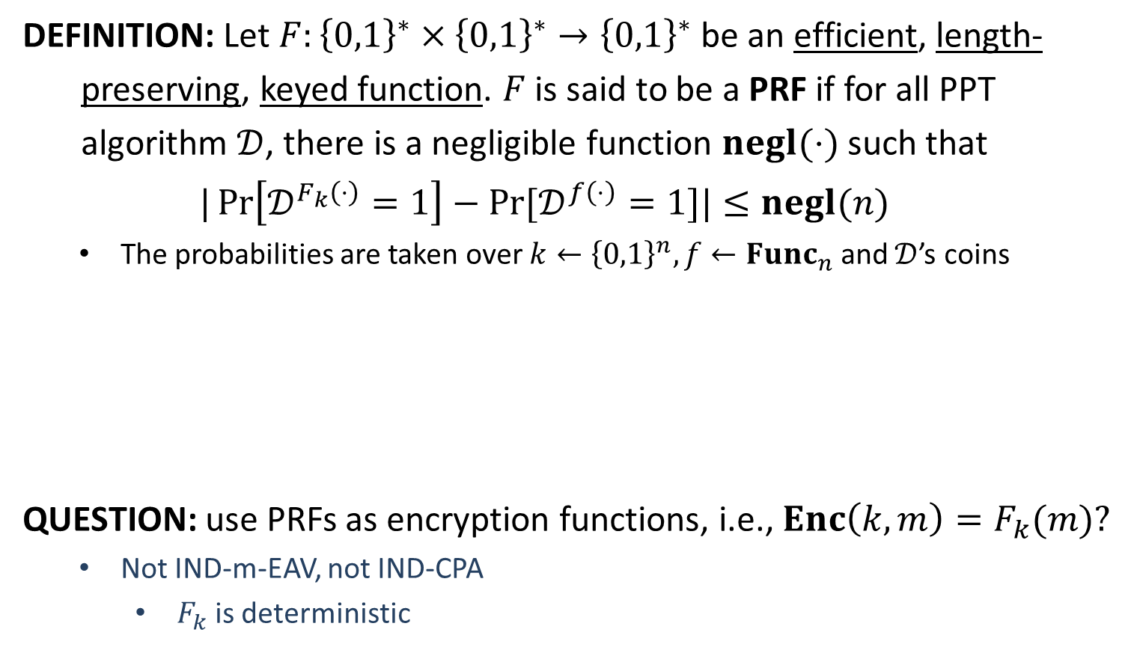





PRF
DEFINITION: Let $F:{\left\{0,1\right\}}^{∗}×{\left\{0,1\right\}}^{∗}→{\left\{0,1\right\}}^{∗}$ be an efficient, length-
preserving, keyed function. $F$ is said to be a PRF if for all PPT
algorithm $𝒟$, there is a negligible function $negl(⋅)$ such that
$$|\operatorname{Pr}\left[𝒟^{F_{k}\left(⋅\right)}=1\right]−Pr⁡[𝒟^{f\left(⋅\right)}=1]|≤negl(n)$$
The probabilities are taken over $k←{\left\{0,1\right\}}^{n}, f←Func_{n}$ and $𝒟$’s coins
QUESTION: use PRFs as encryption functions, i.e., $Enc\left(k,m\right)=F_{k}(m)?$
Not IND-m-EAV, not IND-CPA
$F_{k}$is deterministic
$$y_{i}=𝒪(x_{i})$$
$$𝒟$$
$$x_{1},x_{2},…,x_{q}$$
$$𝒪=F_{k} or f$$
$$b$$
$$y_{1},y_{2},…,y_{q}$$

Slide 4
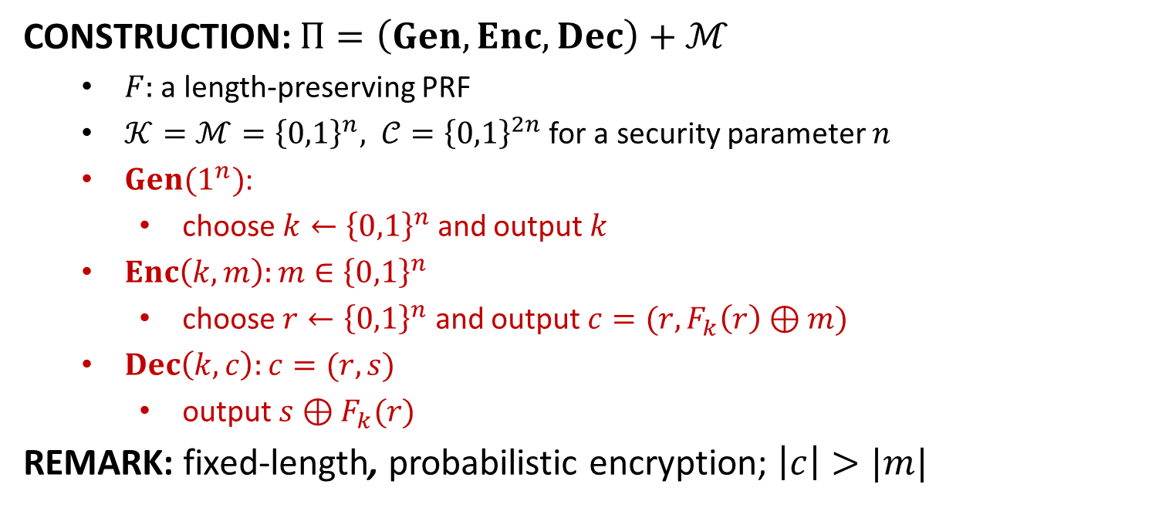
IND-CPA from PRF
CONSTRUCTION: $Π=\left(Gen,Enc, Dec\right)+ℳ$
$F:$ a length-preserving PRF
$𝒦=ℳ={\left\{0,1\right\}}^{n}, 𝒞={\left\{0,1\right\}}^{2n}$ for a security parameter $n$
$Gen(1^{n})$:
choose $k←{\left\{0,1\right\}}^{n}$ and output $k$
$Enc\left(k,m\right):m∈{\left\{0,1\right\}}^{n}$
choose $r←{\left\{0,1\right\}}^{n}$ and output $c=(r,F_{k}\left(r\right)⊕m)$
$Dec\left(k,c\right):c=(r,s)$
output $s⊕F_{k}(r)$
REMARK: fixed-length, probabilistic encryption; $\left|c\right|>|m|$

Slide 5
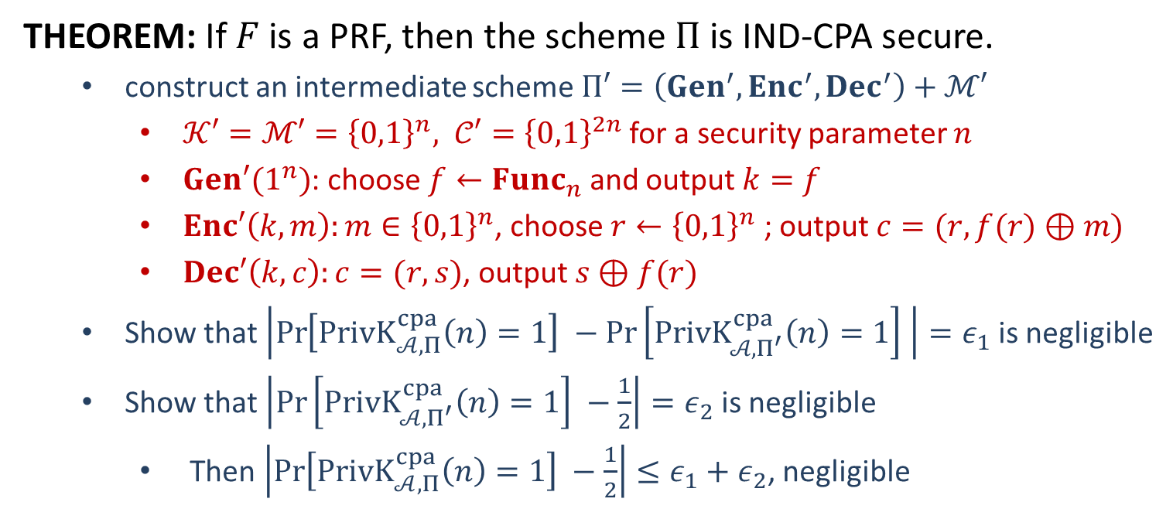
Security
THEOREM: If $F$ is a PRF, then the scheme $Π$ is IND-CPA secure.
construct an intermediate scheme $Π′=\left(Gen^{′},Enc^{′}, Dec^{′}\right)+ℳ′$
$𝒦′=ℳ′={\left\{0,1\right\}}^{n}, 𝒞′={\left\{0,1\right\}}^{2n}$ for a security parameter $n$
$Gen′(1^{n})$: choose $f←Func_{n}$ and output $k=f$
$Enc′\left(k,m\right):m∈{\left\{0,1\right\}}^{n}$, choose $r←{\left\{0,1\right\}}^{n}$ ; output $c=(r,f(r)⊕m)$
$Dec′\left(k,c\right):c=(r,s)$, output $s⊕f(r)$
Show that $\left|\operatorname{Pr}\left[PrivK_{𝒜, Π}^{cpa}\left(n\right)=1\right] −\operatorname{Pr}\left[PrivK_{𝒜, Π^{′}}^{cpa}\left(n\right)=1\right] \right|=ε_{1}$ is negligible
Show that $\left|\operatorname{Pr}\left[PrivK_{𝒜, Π^{′}}^{cpa}\left(n\right)=1\right] −\frac{1}{2}\right|=ε_{2}$ is negligible
Then $\left|\operatorname{Pr}\left[PrivK_{𝒜, Π}^{cpa}\left(n\right)=1\right] −\frac{1}{2}\right|≤ε_{1}+ε_{2}$, negligible

Slide 6








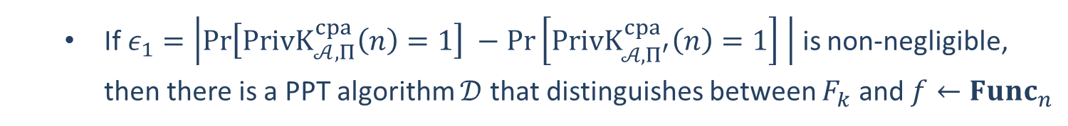














If $ε_{1}=\left|\operatorname{Pr}\left[PrivK_{𝒜, Π}^{cpa}\left(n\right)=1\right] −\operatorname{Pr}\left[PrivK_{𝒜, Π^{′}}^{cpa}\left(n\right)=1\right] \right|$ is non-negligible, then there is a PPT algorithm $𝒟$ that distinguishes between $F_{k}$ and $f←Func_{n}$
$$𝒪$$
$$𝒜$$
$$x_{i}$$
$$r_{i}$$
$$r_{i}←{\left\{0,1\right\}}^{n}$$
$$𝒪(r_{i})$$
$$(r_{i},𝒪\left(r_{i}\right)⊕x_{i})$$
$$m_{0},m_{1}$$
$$r$$
$$r←{\left\{0,1\right\}}^{n}$$
$$\left|m_{0}\right|=|m_{1}|$$
$$b←\{0,1\}$$
$$𝒪(r)$$
$$(r,𝒪\left(r\right)⊕m_{b})$$
$$x_{i}$$
$$r_{i}$$
$$r_{i}←{\left\{0,1\right\}}^{n}$$
$$𝒪(r_{i})$$
$$(r_{i},𝒪\left(r_{i}\right)⊕x_{i})$$
$$b^{′′}=\left\{\begin{aligned}0 b^{′}≠b \\ 1 b^{′}=b\end{aligned}\right.$$
$$b′$$
$$𝒟$$

Slide 7
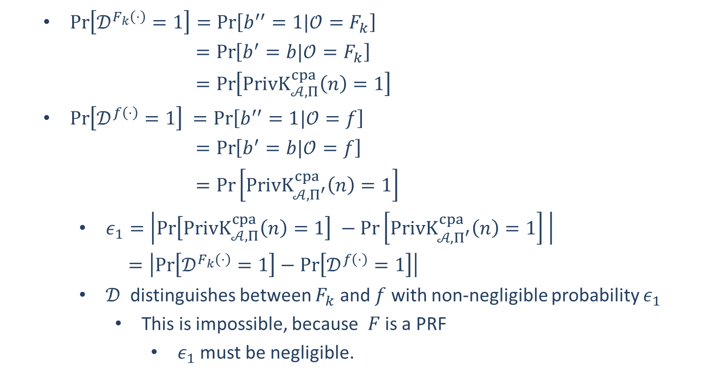
$\operatorname{Pr}\left[𝒟^{F_{k}\left(⋅\right)}=1\right]=\operatorname{Pr}\left[b^{′′}=1|𝒪=F_{k}\right]$
$=\operatorname{Pr}\left[b^{′}=b|𝒪=F_{k}\right]$
$=\operatorname{Pr}\left[PrivK_{𝒜, Π}^{cpa}\left(n\right)=1\right]$
$\operatorname{Pr}\left[𝒟^{f\left(⋅\right)}=1\right] =\operatorname{Pr}\left[b^{′′}=1|𝒪=f\right]$
$=\operatorname{Pr}\left[b^{′}=b|𝒪=f\right]$
$=\operatorname{Pr}\left[PrivK_{𝒜, Π^{′}}^{cpa}\left(n\right)=1\right]$
$ε_{1}=\left|\operatorname{Pr}\left[PrivK_{𝒜, Π}^{cpa}\left(n\right)=1\right] −\operatorname{Pr}\left[PrivK_{𝒜, Π^{′}}^{cpa}\left(n\right)=1\right] \right|$
$=\left|\operatorname{Pr}\left[𝒟^{F_{k}\left(⋅\right)}=1\right]−\operatorname{Pr}\left[𝒟^{f\left(⋅\right)}=1\right]\right|$
$𝒟$ distinguishes between $F_{k}$ and $f$ with non-negligible probability $ε_{1}$
This is impossible, because $F$ is a PRF
$ε_{1}$ must be negligible.

Slide 8

















Show that $ε_{2}=\left|\operatorname{Pr}\left[PrivK_{𝒜, Π^{′}}^{cpa}\left(n\right)=1\right] −1/2\right|$ is negligible.
Consider the IND-CPA security game of $Π^{′}$
$$f←Func_{n}$$
$$𝒜$$
$$x_{i}$$
$$r_{i}←{\left\{0,1\right\}}^{n}$$
$$(r_{i},f\left(r_{i}\right)⊕x_{i})$$
$$m_{0},m_{1}$$
$$\left|m_{0}\right|=|m_{1}|$$
$$r←{\left\{0,1\right\}}^{n}$$
$$challenger$$
$$b←\{0,1\}$$
$$(r,f\left(r\right)⊕m_{b})$$
$$x_{i}$$
$$r_{i}←{\left\{0,1\right\}}^{n}$$
$$(r_{i},f\left(r_{i}\right)⊕x_{i})$$
$$b^{′′}=\left\{\begin{aligned}0 b^{′}≠b \\ 1 b^{′}=b\end{aligned}\right.$$
$$b′$$

Slide 9
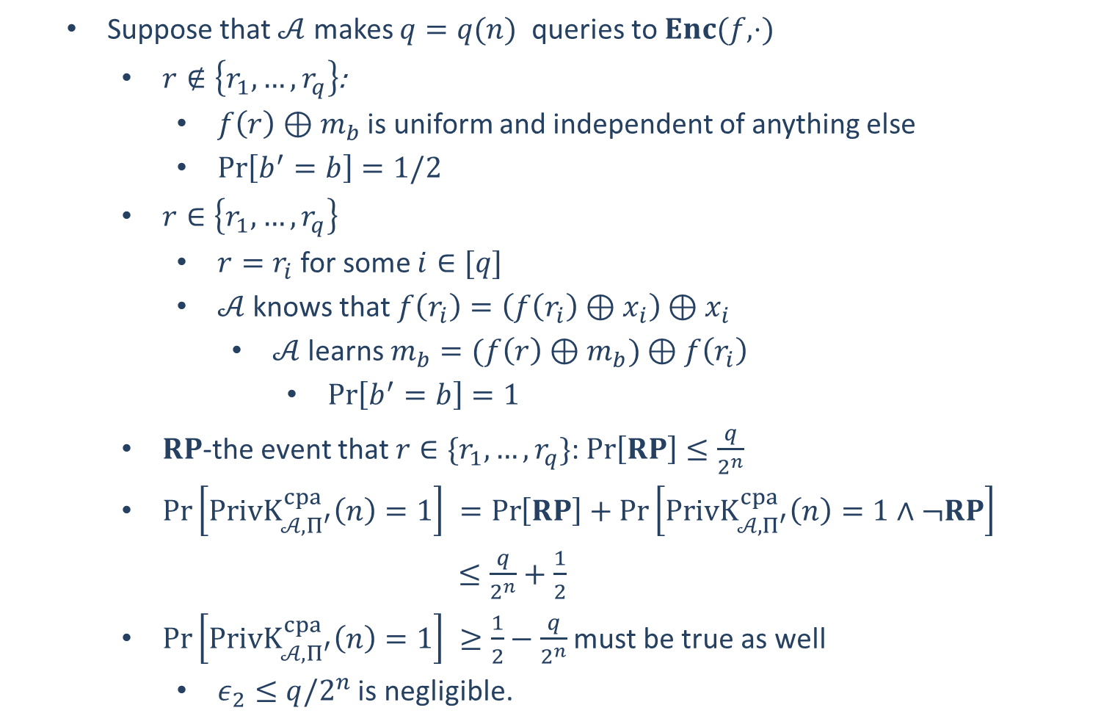
Suppose that $𝒜$ makes $q=q(n)$ queries to $Enc(f,⋅)$
$r∉\left\{r_{1},…,r_{q}\right\}$:
$f\left(r\right)⊕m_{b}$ is uniform and independent of anything else
$\operatorname{Pr}\left[b^{′}=b\right]=1/2$
$r∈\left\{r_{1},…,r_{q}\right\}$
$r=r_{i}$ for some $i∈[q]$
$𝒜$ knows that $f\left(r_{i}\right)=\left(f\left(r_{i}\right)⊕x_{i}\right)⊕x_{i}$
$𝒜$ learns $m_{b}=(f\left(r\right)⊕m_{b})⊕f\left(r_{i}\right)$
$\operatorname{Pr}\left[b^{′}=b\right]=1$
$RP$-the event that $r∈\{r_{1},…,r_{q}\}$: $\operatorname{Pr}\left[RP\right]≤\frac{q}{2^{n}}$
$\operatorname{Pr}\left[PrivK_{𝒜, Π^{′}}^{cpa}\left(n\right)=1\right] =\operatorname{Pr}\left[RP\right]+\operatorname{Pr}\left[PrivK_{𝒜, Π^{′}}^{cpa}\left(n\right)=1∧¬RP\right]$
$≤\frac{q}{2^{n}}+\frac{1}{2}$
$\operatorname{Pr}\left[PrivK_{𝒜, Π^{′}}^{cpa}\left(n\right)=1\right] ≥\frac{1}{2}−\frac{q}{2^{n}}$ must be true as well
$ε_{2}≤q/2^{n}$ is negligible.

